Slide 1
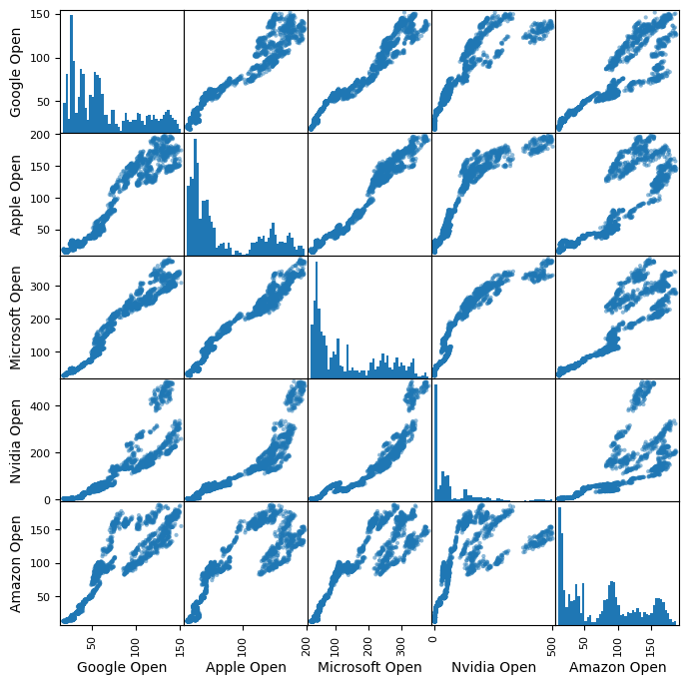
Scatter Plot
Key Observations:
The strongest positive correlations appear to be between Microsoft-Apple, Google-Microsoft, and Google-Apple.
NVIDIA shows a positive correlation with both Microsoft and Apple but to a slightly lesser degree.
Amazon's opening prices, while still positively correlated with the others, show the most variation.

Slide 2
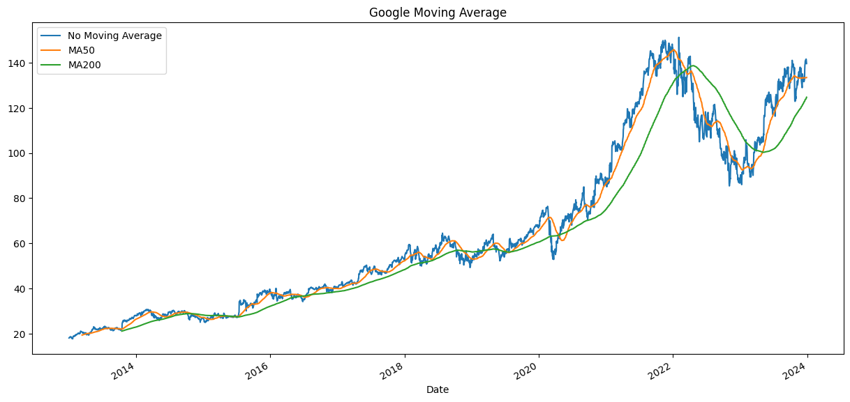
Golden Cross: This occurs when a short-term moving average (like the MA50) crosses above a long-term moving average (like the MA200). It is considered a bullish signal.
Death Cross: The opposite of a golden cross, a death cross happens when a short-term moving average crosses below a long-term moving average. It is perceived as a bearish signal

Slide 3
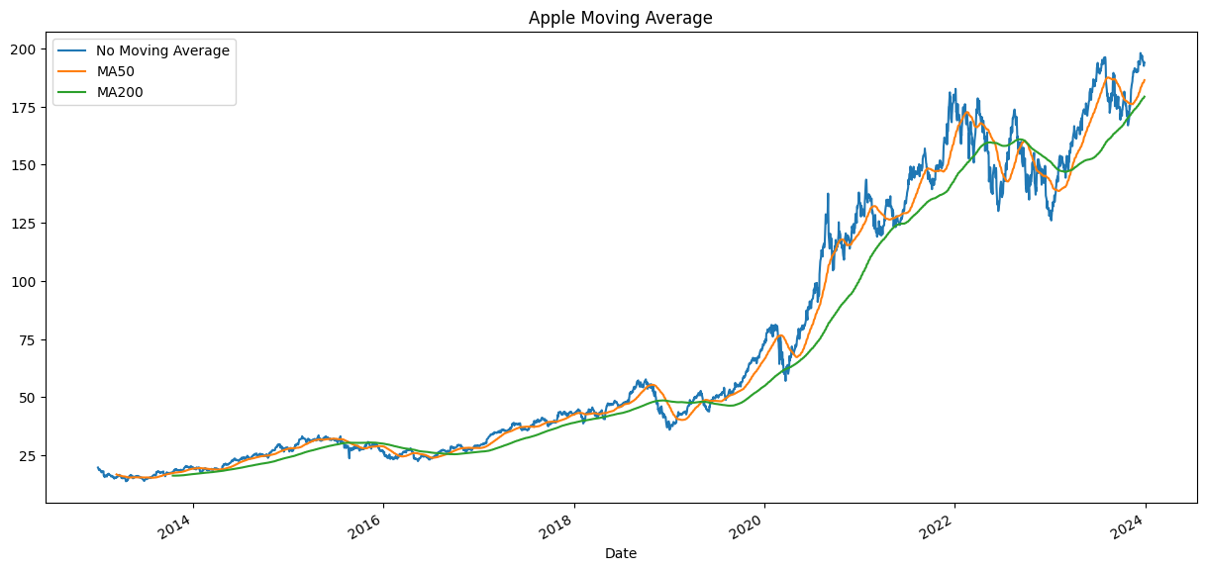
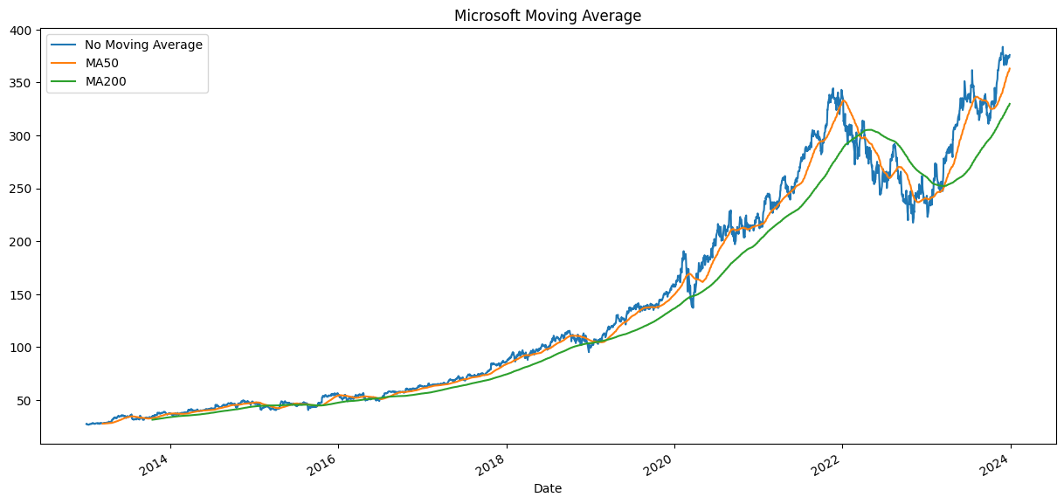

Slide 4
